Slide 1
Capstone Project: Stock Price Prediction
Pp99681n@pace.edu
Presented by : priyanshkumar parsana
Git link : https://github.com/priyanshkumarparsana1/CapStone-Project-DATA-SCIENCE/tree/main

Slide 2
PROBLEM STATEMENT
Stock markets are volatile and influenced by multiple factors. Predicting stock prices can help investors make better decisions. Traditional methods struggle with complex patterns in financial time series data, but machine learning may capture these patterns more effectively.

Slide 3
PROJECT GOALS
1.Data science to analyze stock behavior.
2.Predict outcomes for future trading days.
3.Provide actionable insights through interactive visualizations.

Slide 4
Key Objectives
Data Acquisition & Preparation – Ensure accurate analysis.
Exploratory Data Analysis – Identify important patterns.
Predictive Modeling – Forecast stock behavior.
Interactive Visualization
Insight Generation – Provide strategic recommendations.
Integration & Deployment – Implement insights into business.
Performance Monitoring – Maintain model accuracy over time.

Slide 5
Tools and Libraries:
Data Sources:
Yahoo Finance API (using yfinance Python package)
Example Stocks: Apple (AAPL), Tesla (TSLA), Microsoft (MSFT)
You can also expand to indexes like S&P 500 (GSPC).
Python
Libraries:
numpy, pandas, scikit-learn
matplotlib, seaborn
keras, tensorflow (for deep learning)
yfinance (for data collection)

Slide 6
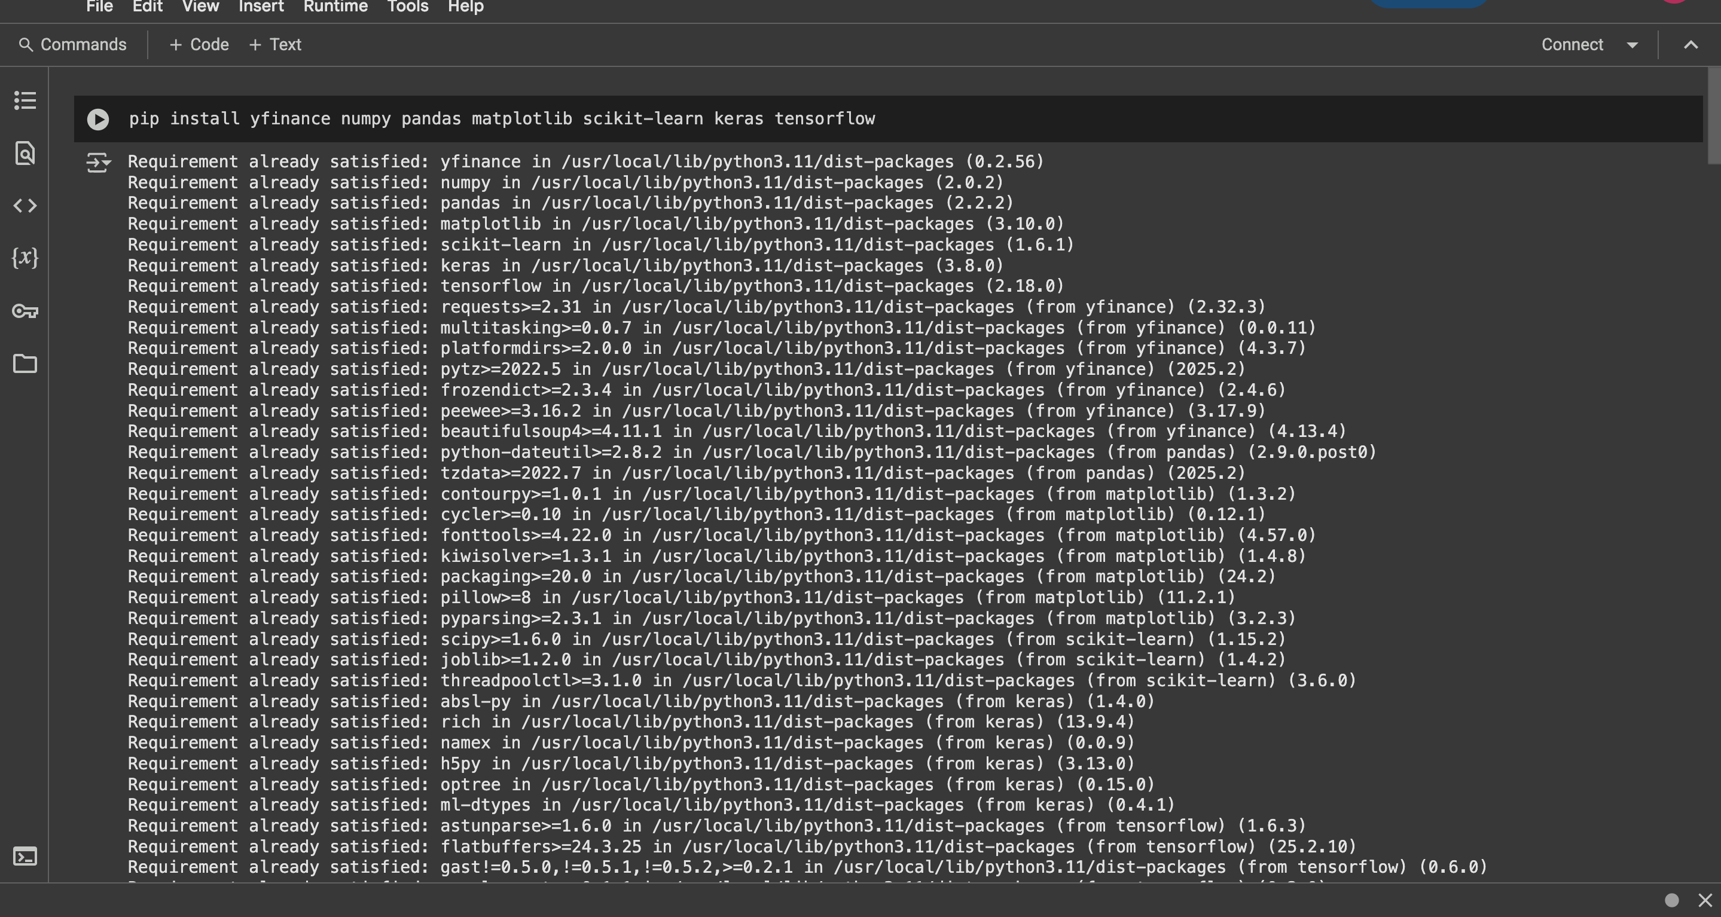
Installing yahoo finance database

Slide 7
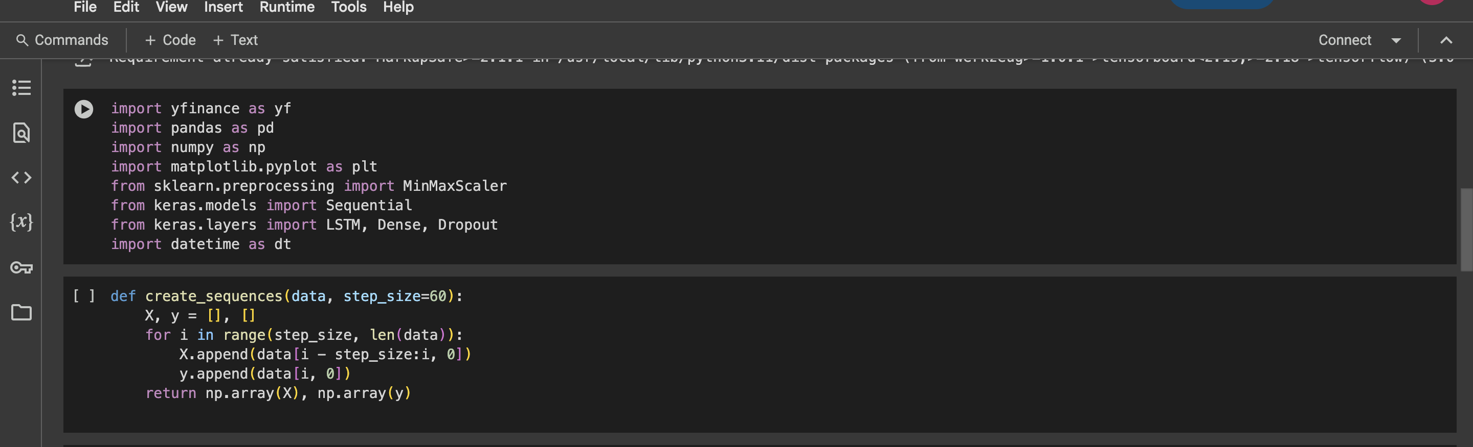
Importing Libraries

Slide 8
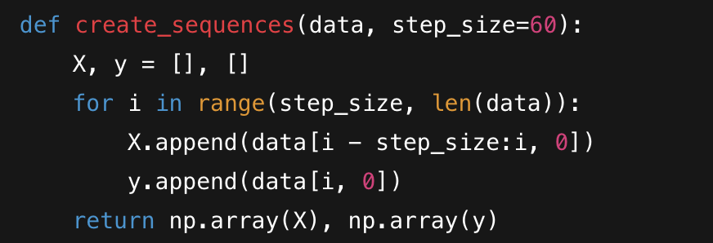
🧩 Cell 3: Sequence Creation Function
Purpose: Converts time-series data into input-output sequences for training the model.
Details:
step_size=60: Means the model will use the past 60 time steps (e.g., days) to predict the next one.
X: Contains sequences of 60 previous values.
y: Contains the next value (i.e., the prediction target).

Slide 9
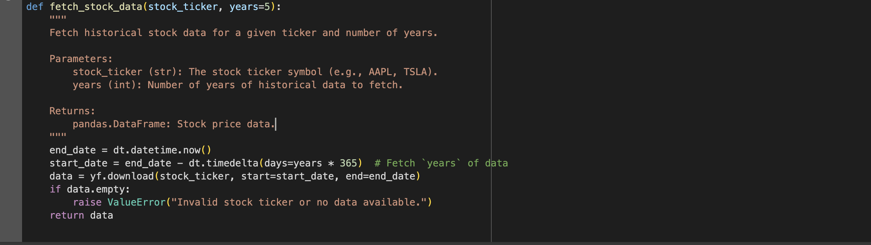

Slide 10

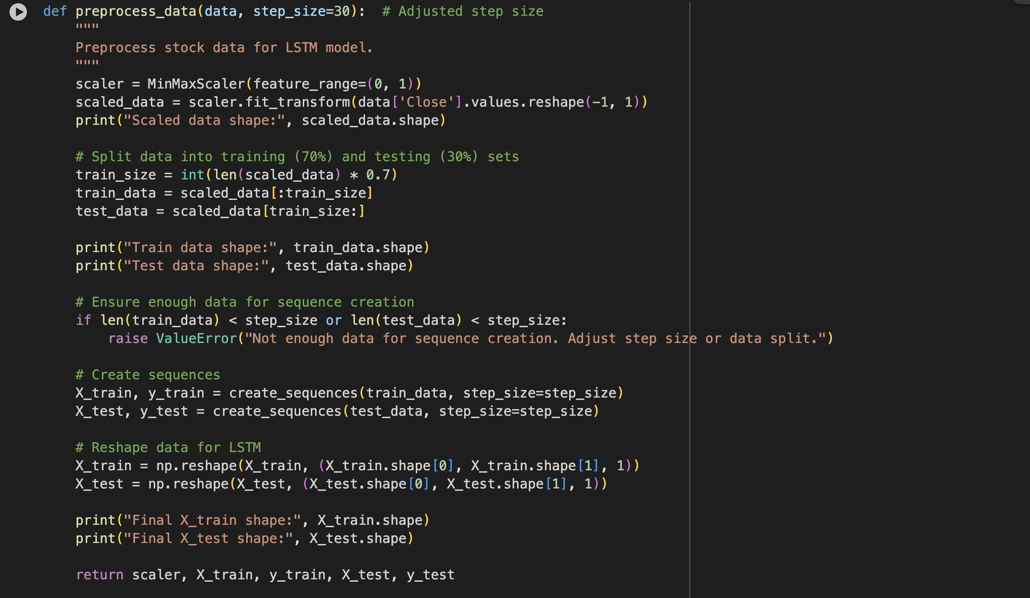

Slide 11
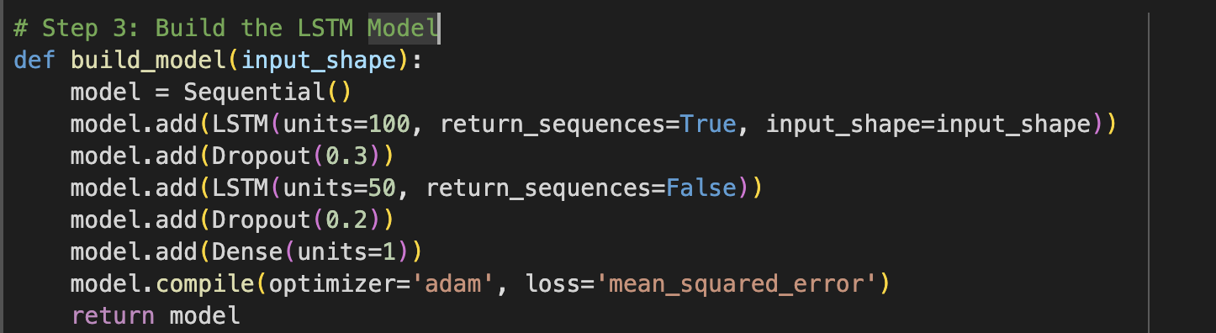
Building the lstm model

Slide 12
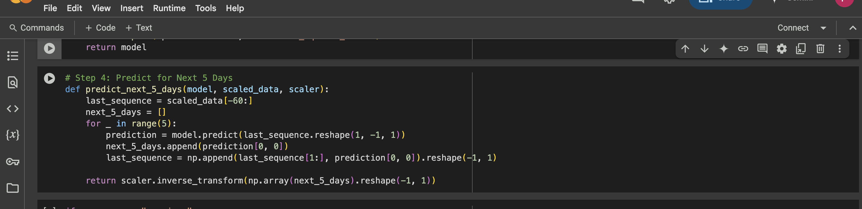
Predicting the next 5 days

Slide 13
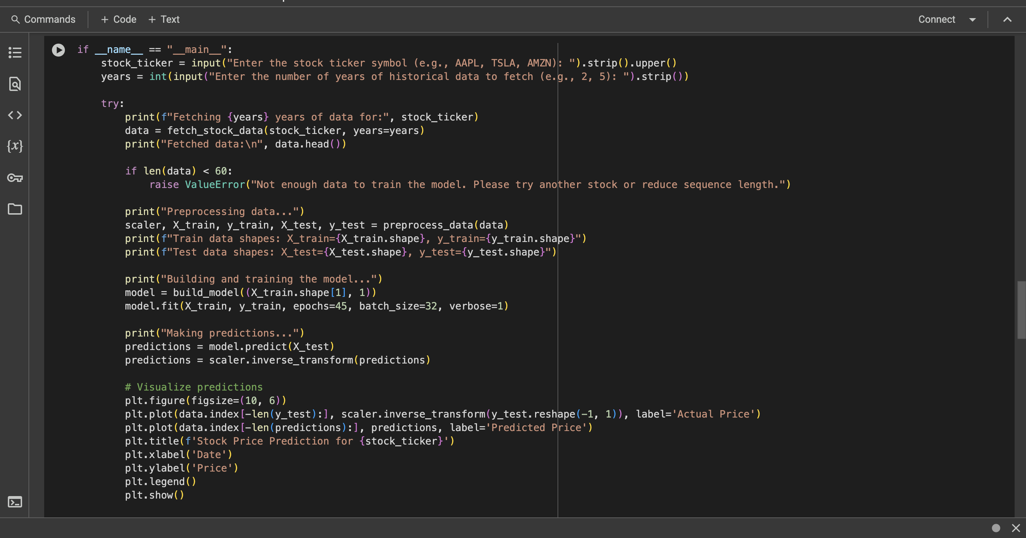
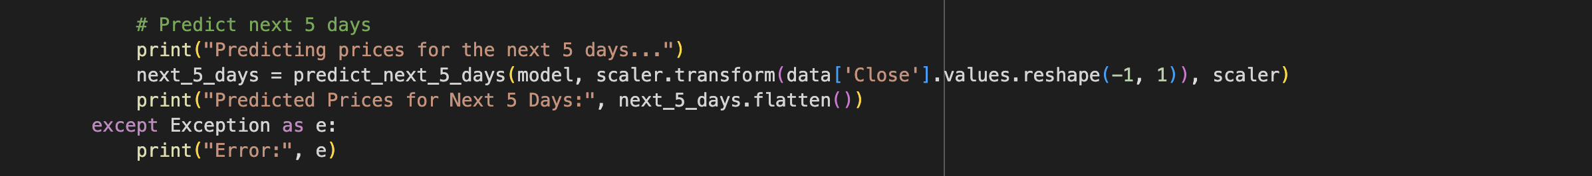
ALGORITHM

Slide 14
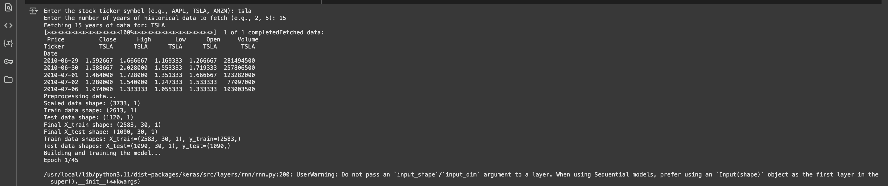
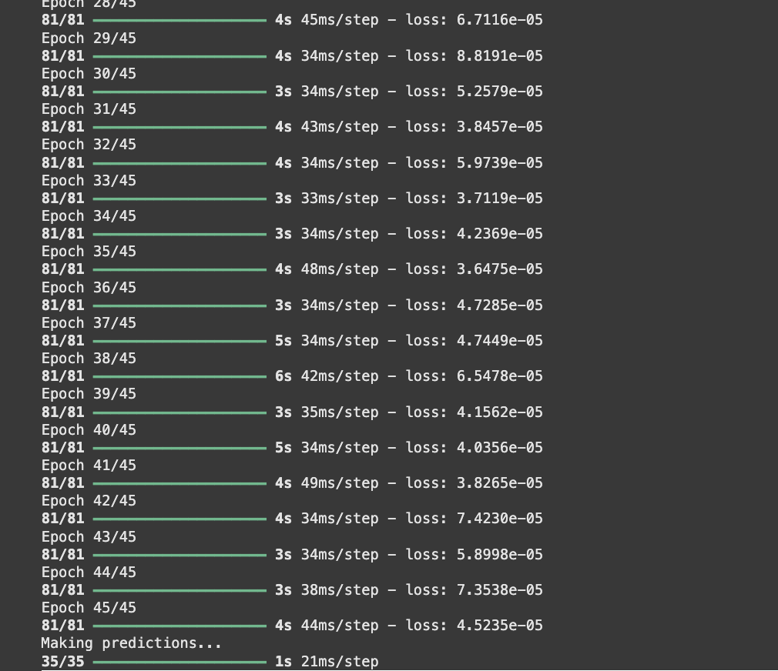
EPOCHS RUNNING 45

Slide 15
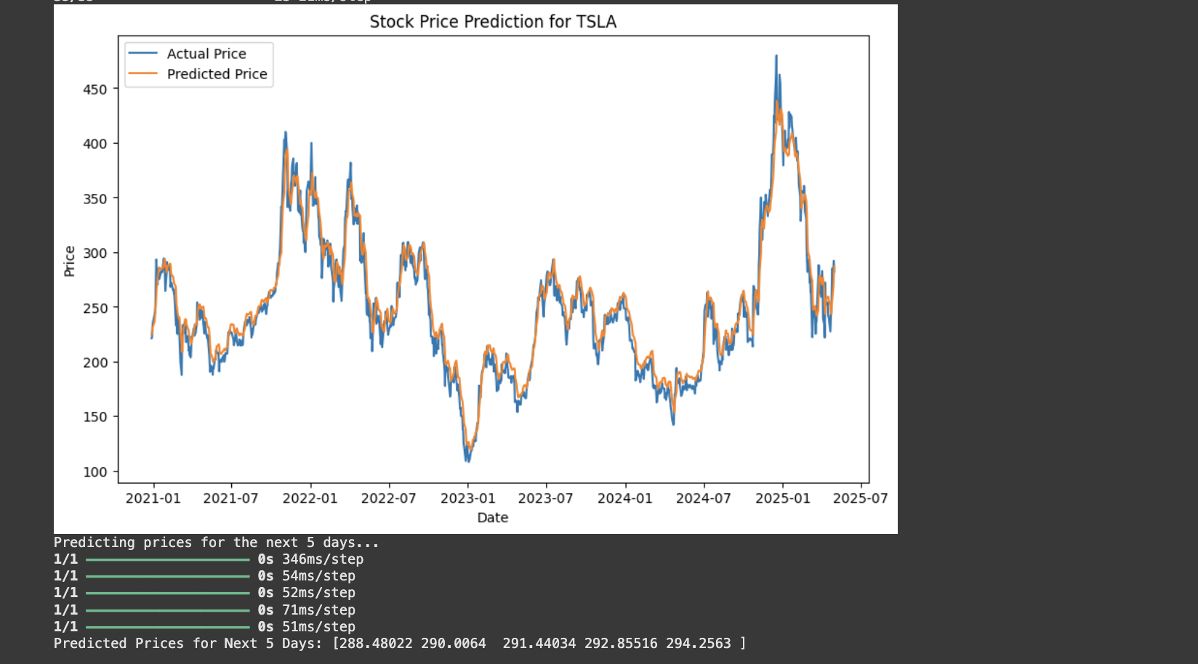
PREDICTION GRAPH OF ACTUAL PRICE VS PREDICTIED PRICE

Slide 16
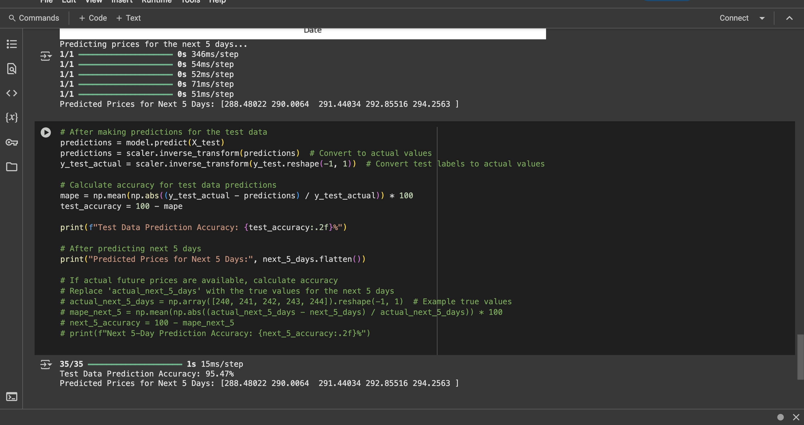
Accuracy calculation and making output for next 5 days

Slide 17
Lets us also run the code and understand

Slide 18
Conclusion
This project demonstrates how to use deep learning techniques, particularly LSTM networks, for time series forecasting. It showcases practical applications in financial modeling and prediction.
Machine learning models can provide valuable predictions but are still limited by real-world uncertainties.
Future Work
Include sentiment analysis from news headlines.
Use more complex deep learning architectures.
Develop a real-time prediction web app.

Slide 19
Thankyou
👤 Author
Priyanshkumar Parsana. PP99681N Data Science Capstone | Pace University | April 2025

